Slide 1

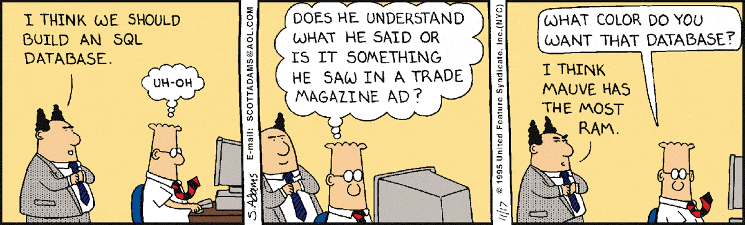
Libraries & Linked Data From a Linked Data point of view
Nicholas Car GA’s Data Architect & member, Aust gov Linked Data WG
I THINK WE SHOULD BUILD A LINKED DATA SYSTEM
SYSTEM?

Slide 2
Outline
Who is the AGLDWG and what does it do?
Internal drivers: GA’s library and multi-collection use of LD
Libraries and Semantic Web vocabs, current & future
The Big Database in the Sky: the future Semantic Web

Slide 3
What is Linked Data?
“Linked Data provides a publishing paradigm in which not only documents [web pages] but also data can be first class citizens of the Web”^{[1]}
^{[1]} Linked Data: Evolving the Web into a Global Data SpaceHeath, T. & Bizer, C., 2011. Linked Data: Evolving the Web into a Global Data SpaceJ. Hendler, ed., Morgan & Claypool. Available at: http://linkeddatabook.com.

Slide 4
What is Linked Data?
“Linked Data provides a publishing paradigm in which not only documents [web pages] but also data can be first class citizens of the Web”^{[1]}
The Semantic Web is an extension of the Web through standards by the World Wide Web Consortium (W3C). The standards promote common data formats and exchange protocols^{[2]}
^{[1]} Linked Data: Evolving the Web into a Global Data SpaceHeath, T. & Bizer, C., 2011. Linked Data: Evolving the Web into a Global Data SpaceJ. Hendler, ed., Morgan & Claypool. Available at: http://linkeddatabook.com.
^{[2]} https://en.wikipedia.org/wiki/Semantic_Web

Slide 5
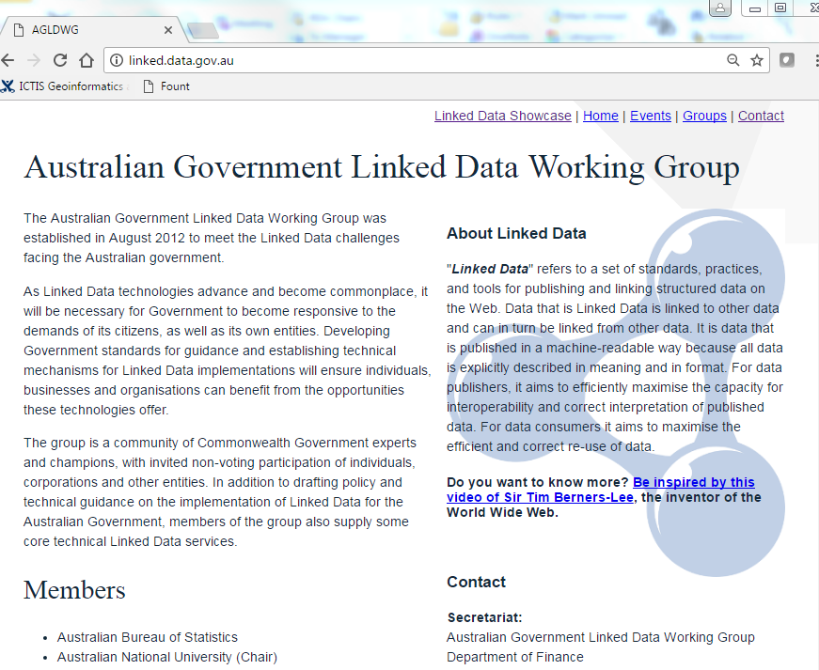
Australian Govt. Linked Data Working Group

Slide 6
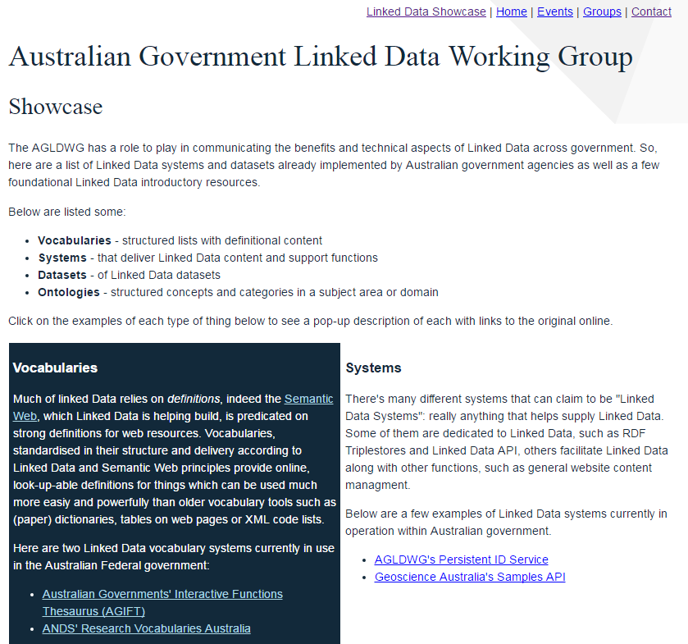
Australian Govt. Linked Data Working Group

Slide 7


Internal drivers: GA’s library and multi-collection use of LD
GA has always worked with standards:

Slide 8

Internal drivers: GA’s library and multi-collection use of LD
GA has always worked with standards:

Slide 9
Internal drivers: GA’s library and multi-collection use of LD
GA has always worked with standards
What’s new?
Semantic Web universality
Linked Data access mechanisms

Slide 10
Internal drivers: GA’s library and multi-collection use of LD
GA has always worked with standards
What’s new?
Semantic Web universality
Linked Data access mechanisms
This is exciting stuff!

Slide 11
Internal drivers: GA’s library and multi-collection use of LD
GA has always worked with standards
What’s new?
Semantic Web universality
Linked Data access mechanisms
Dataset
Service
Multiple models in play at the same time.
Important for different
internal users
PROV, DCAT, Data Provider Node…

Slide 12
Internal drivers: GA’s library and multi-collection use of LD
GA has always worked with standards
What’s new?
Semantic Web universality
Linked Data access mechanisms
ISO 19115-1
ISO 19115
DCAT
ISO 19115-3
Multiple access methods.
Also important for internal
Users.
provenance
LD methods to choose

Slide 13
Internal drivers: GA’s library and multi-collection use of LD
GA has always worked with standards
What’s new?
Semantic Web universality
Linked Data access mechanisms
Multi collection access – internal
Geoscience Australia
Linked Data
Legacy X
Legacy Y
Legacy Z

Slide 14
Internal drivers: GA’s library and multi-collection use of LD
GA has always worked with standards
What’s new?
Semantic Web universality
Linked Data access mechanisms
Multi collection access – internal/external
System Z
Geoscience Australia
Linked Data
Legacy X
Legacy Y

Slide 15
Internal drivers: GA’s library and multi-collection use of LD
GA has always worked with standards
What’s new?
Semantic Web universality
Linked Data access mechanisms
Multi collection access – Library e.g.
Geoscience Australia
Linked Data
Field Notebooks
Photos
Samples Catalogue

Slide 16
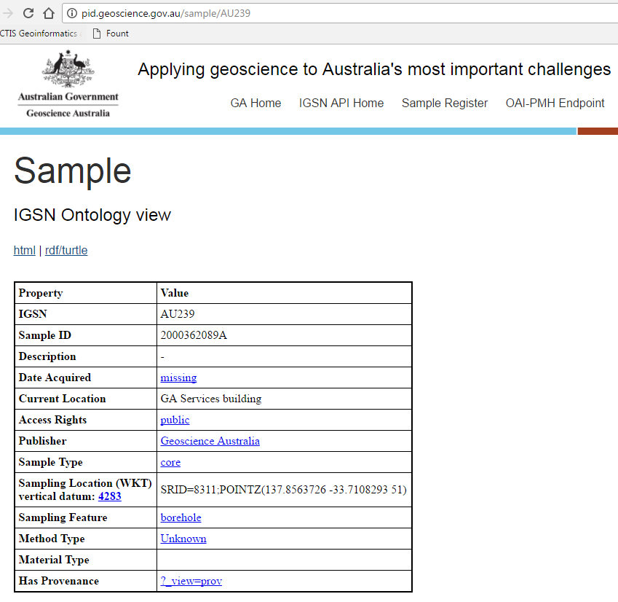
Internal drivers: GA’s library and multi-collection use of LD
GA has always worked with standards
What’s new?
Semantic Web universality
Linked Data access mechanisms
Multi collection access – Library e.g.
Geoscience Australia
Linked Data
Field Notebooks
Photos
Samples Catalogue

Slide 17
Internal drivers: GA’s library and multi-collection use of LD
GA has always worked with standards
What’s new?
Semantic Web universality
Linked Data access mechanisms
Multi collection access – Library e.g.
Field Notebook
These independent collections now operate as a federated database
Image
Sample

Slide 18
Libraries and Semantic Web vocabs, current & future
The key to good Linked Data is good data management
Libraries organise many things

Slide 19
Libraries and Semantic Web vocabs, current & future
The key to good Linked Data is good data management
Libraries organise many things
Libraries have always worked with classification
Ashurbanipal’s indexes
LoC Subject Headings

Slide 20
Libraries and Semantic Web vocabs, current & future
The key to good Linked Data is good data management
Libraries organise many things
Libraries have always worked with classification
Ashurbanipal’s indexes
LoC Subject Headings
Libraries have always worked with interoperable collection mechanisms:
OAI-PMH, MARC etc.

Slide 21
Libraries and Semantic Web vocabs, current & future
Data management
Classification
Interoperability

Slide 22
Libraries and Semantic Web vocabs, current & future
Data management
Classification
Interoperability
Still required!

Slide 23
Libraries and Semantic Web vocabs, current & future
Data management
Classification
Interoperability
Helped by modern vocabulary and ontology tools

Slide 24
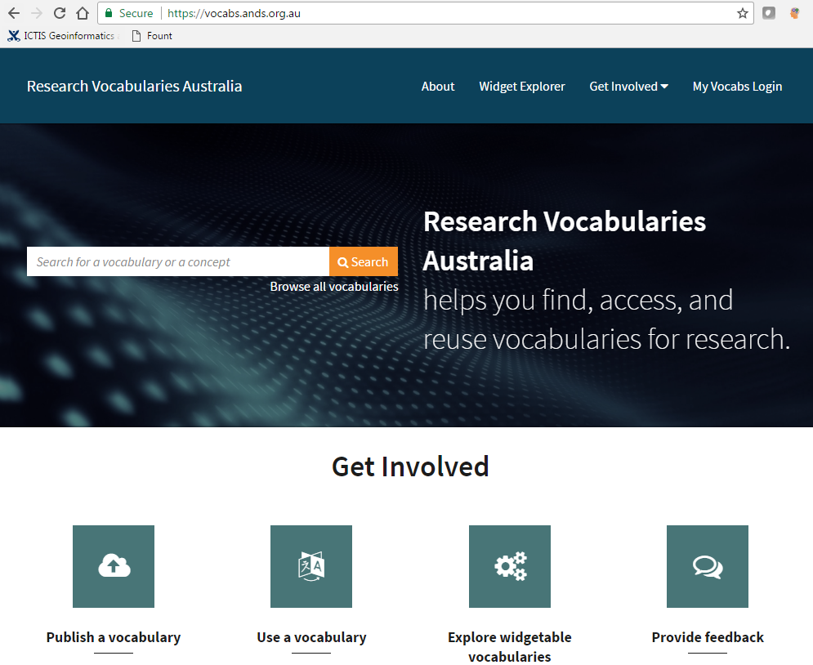
Libraries and Semantic Web vocabs, current & future
Data management
Classification
Interoperability
The RVA vocab portal

Slide 25
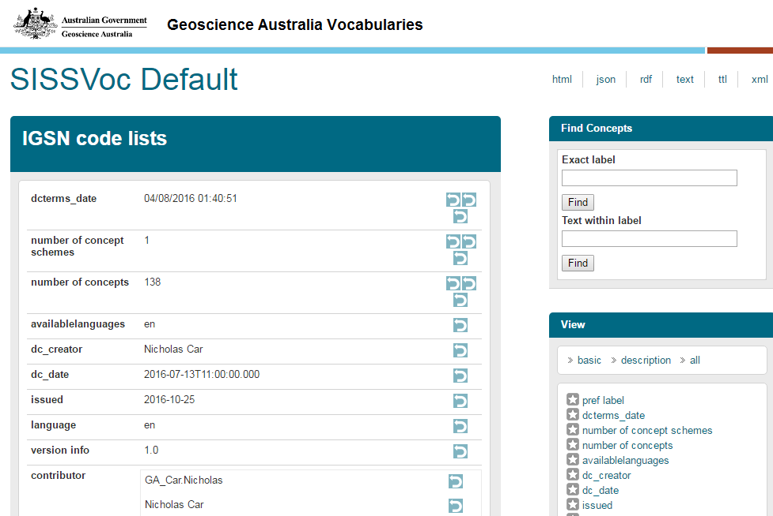
Libraries and Semantic Web vocabs, current & future
Data management
Classification
Interoperability
A particular vocab, managed by GA and others

Slide 26
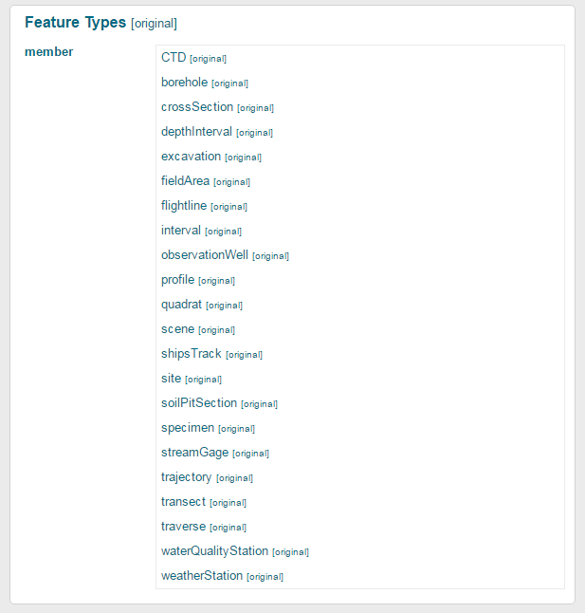
Libraries and Semantic Web vocabs, current & future
Data management
Classification
Interoperability
Feature Types relevant to a sample – managed list

Slide 27
Libraries and Semantic Web vocabs, current & future
Data management
Classification
Interoperability
Helped by using “normal” Internet protocols

Slide 28
Libraries and Semantic Web vocabs, current & future
Reminder:
“Linked Data provides a publishing paradigm in which not only documents [web pages] but also data can be first class citizens of the Web”

Slide 29
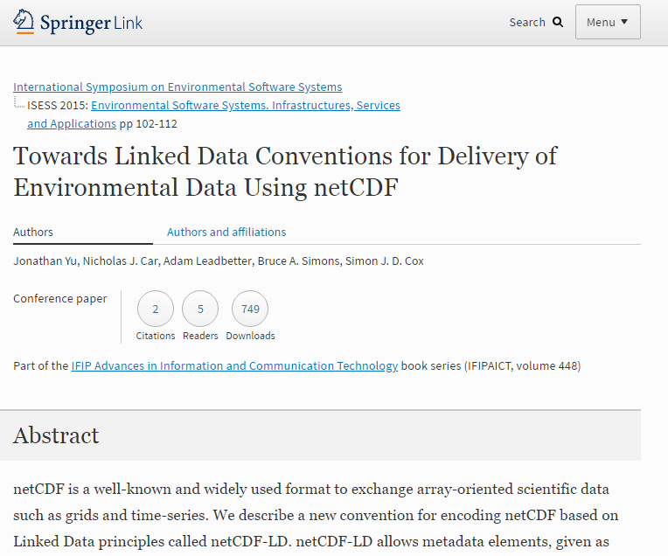
Example: DOIs
DOIs point to web pages:
http://doi.org/10.1007/978-3-319-15994-2_9 → https://link.springer.com/chapter/10.1007%2F978-3-319-15994-2_9

Slide 30
Example: DOIs
DOIs point to web pages:
http://doi.org/10.1007/978-3-319-15994-2_9 → https://link.springer.com/chapter/10.1007%2F978-3-319-15994-2_9
This is the HTML version of the DOI only!

Slide 31
Example: DOIs
DOIs point to web pages:
http://doi.org/10.1007/978-3-319-15994-2_9 → https://link.springer.com/chapter/10.1007%2F978-3-319-15994-2_9
This is the HTML version of the DOI only!
Linked Data, machine readable, version:
http://doi.org/10.1007/978-3-319-15994-2_9 → https://data.crossref.org/10.1007%2F978-3-319-15994-2_9

Slide 32
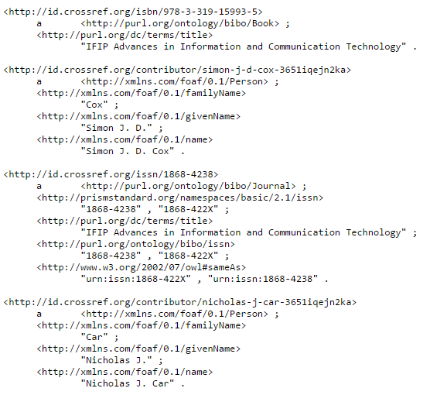
Example: DOIs
DOIs point to web pages:
http://doi.org/10.1007/978-3-319-15994-2_9 → https://link.springer.com/chapter/10.1007%2F978-3-319-15994-2_9
This is the HTML version of the DOI only!
Linked Data, machine readable, version:
http://doi.org/10.1007/978-3-319-15994-2_9 → https://data.crossref.org/10.1007%2F978-3-319-15994-2_9

Slide 33
The Big Database in the Sky: the future Semantic Web
Normal web page linking
Web Page
Web Page
hyperlink

Slide 34
The Big Database in the Sky: the future Semantic Web
Normal web page linking
Style Sheet
typed
hyperlink
Web Page
Web Page
hyperlink

Slide 35
The Big Database in the Sky: the future Semantic Web
Normal web page linking
Semantic Web linking
Style Sheet
typed
hyperlink
Type B
typed
hyperlink
Web Page
Object type A
Web Page
Type C
hyperlink
typed
hyperlink

Slide 36
The Big Database in the Sky: the future Semantic Web
A Relational Database
Node | Edge | Node
u48876 | is a | GA staff member
u48876 | first name | “Nick”
GA staff member | is a | Person

Slide 37
The Big Database in the Sky: the future Semantic Web
A Relational Database
A Graph Database
Node | Edge | Node
u48876 | is a | GA staff member
u48876 | first name | “Nick”
GA staff member | is a | Person
“Nick”
first name
u48876
is a
GA staff member
Person
is a

Slide 38
The Big Database in the Sky: the future Semantic Web
The Internet: a Virtual Graph Database
Subgraph
Subgraph
Subgraph
Subgraph
Subgraph
HTTP/Internet: the pipeline
URIs: the DB/item keys
Semantic Web: the data model

Slide 39
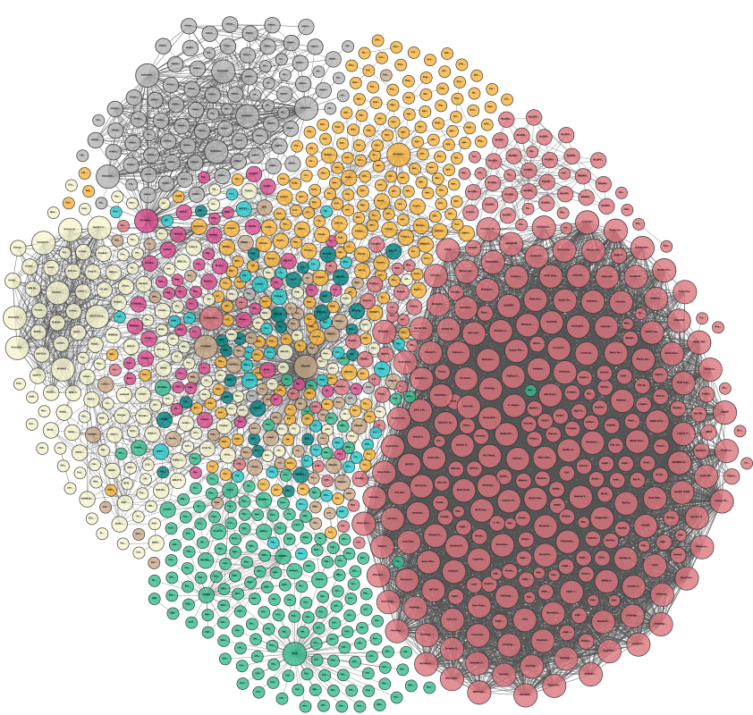
The Big Database in the Sky: the future Semantic Web
The LOD Cloud
Linking Open Data cloud diagram 2017, by Andrejs Abele, John P. McCrae, Paul Buitelaar,
Anja Jentzsch and Richard Cyganiak.
http://lod-cloud.net

Slide 40
The Big Database in the Sky: the future Semantic Web
The LOD Cloud
Linking Open Data cloud diagram 2017, by Andrejs Abele, John P. McCrae, Paul Buitelaar,
Anja Jentzsch and Richard Cyganiak.
http://lod-cloud.net
Universal uniqueness and persistence are very hard

Slide 41
The Big Database in the Sky: the future Semantic Web
The LOD Cloud
Linking Open Data cloud diagram 2017, by Andrejs Abele, John P. McCrae, Paul Buitelaar,
Anja Jentzsch and Richard Cyganiak.
http://lod-cloud.net
Universal uniqueness and persistence are very hard
Libraries know this

Slide 42
The Big Database in the Sky: the future Semantic Web
The LOD Cloud
Linking Open Data cloud diagram 2017, by Andrejs Abele, John P. McCrae, Paul Buitelaar,
Anja Jentzsch and Richard Cyganiak.
http://lod-cloud.net
Universal uniqueness and persistence are very hard
Libraries know this
+ talk to the AGLDWG!

Slide 43
The Big Database in the Sky: the future Semantic Web
Libraries role:
Keep doing your core work of Data management & Classification
Keep striving for more Interoperability

Slide 44
The Big Database in the Sky: the future Semantic Web
Libraries role:
Keep doing your core work of Data management & Classification
Keep striving for more Interoperability
Keep working with data people
A 2-way sharing (I’ve learned a lot)

Slide 45
The Big Database in the Sky: the future Semantic Web
Libraries role:
Keep doing your core work of Data management & Classification
Keep striving for more Interoperability
Keep working with data people
Expect finer granules… of everything

Slide 46
Outline
Who is the AGLDWG and what does it do?
Internal drivers: GA’s library and multi-collection use of LD
Libraries and Semantic Web vocabs, current & future
The Big Database in the Sky: the future Semantic Web

Slide 47
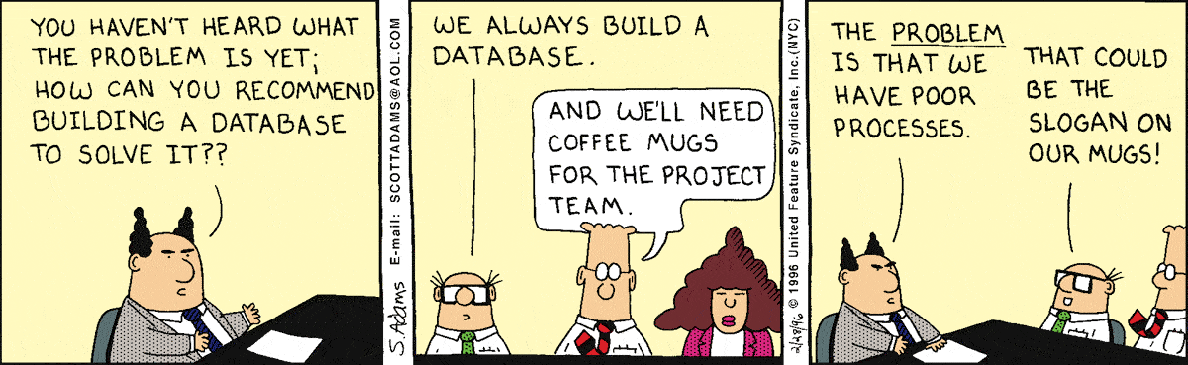
Nicholas Car
Data Architect
Geoscience Australia
nicholas.car@ga.gov.au
LINKED DATA
LINKED DATA

